Slide 1


USWDS Monthly Call
May 2022

Slide 2

Hi!
Thanks for being here!

Slide 3
Agenda
Site launches
Product updates
Packages and performance
Q&A

Slide 4
Site launches

Slide 5
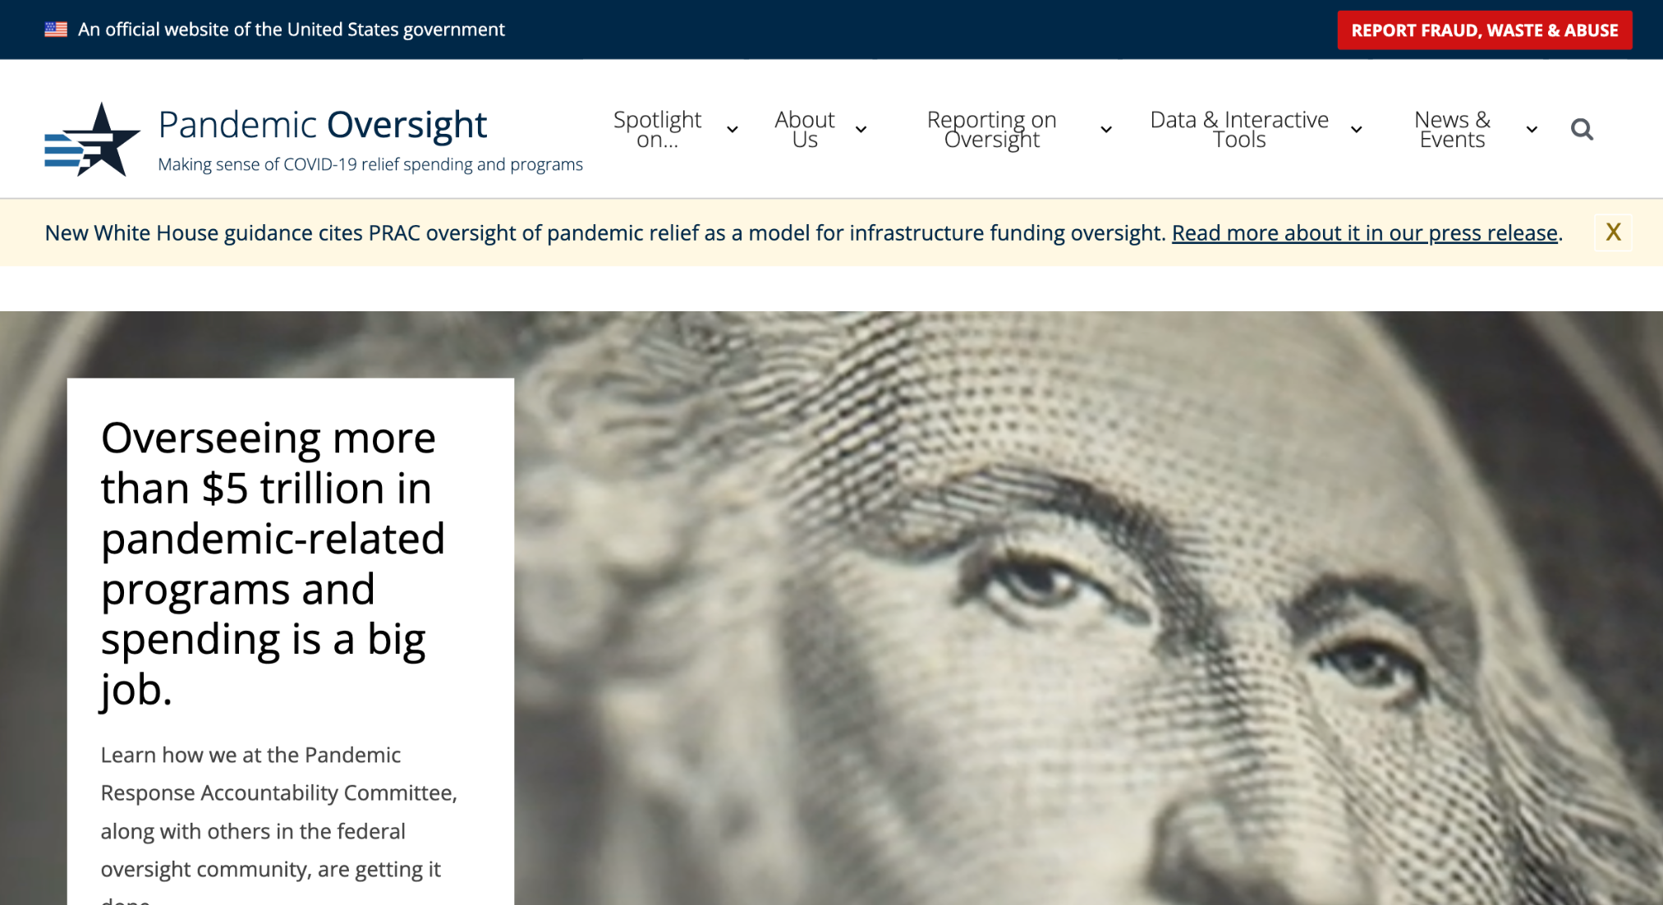
Pandemic Oversight
pandemicoversight.gov

Slide 6
Great work!

Slide 7
Product updates

Slide 8
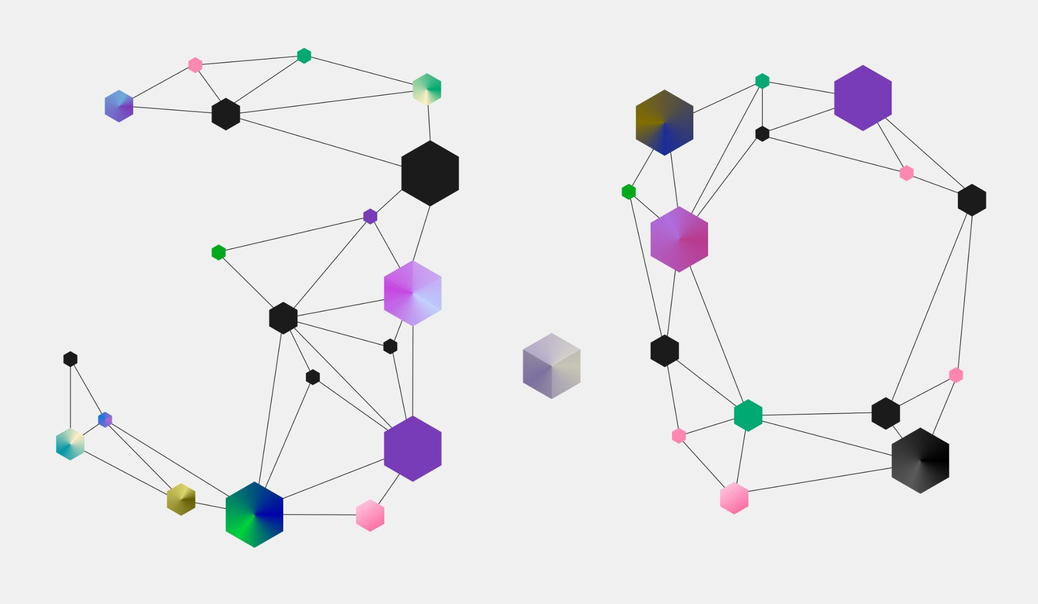
USWDS 3.0 is here

Slide 9
USWDS 3.0
Actually, now it’s 3.0.1

Slide 10
Compile 1.0.0
Tuned up for USWDS 3.0

Slide 11
Packages and performance

Slide 12

USWDS 1.0
20 Components

Slide 13
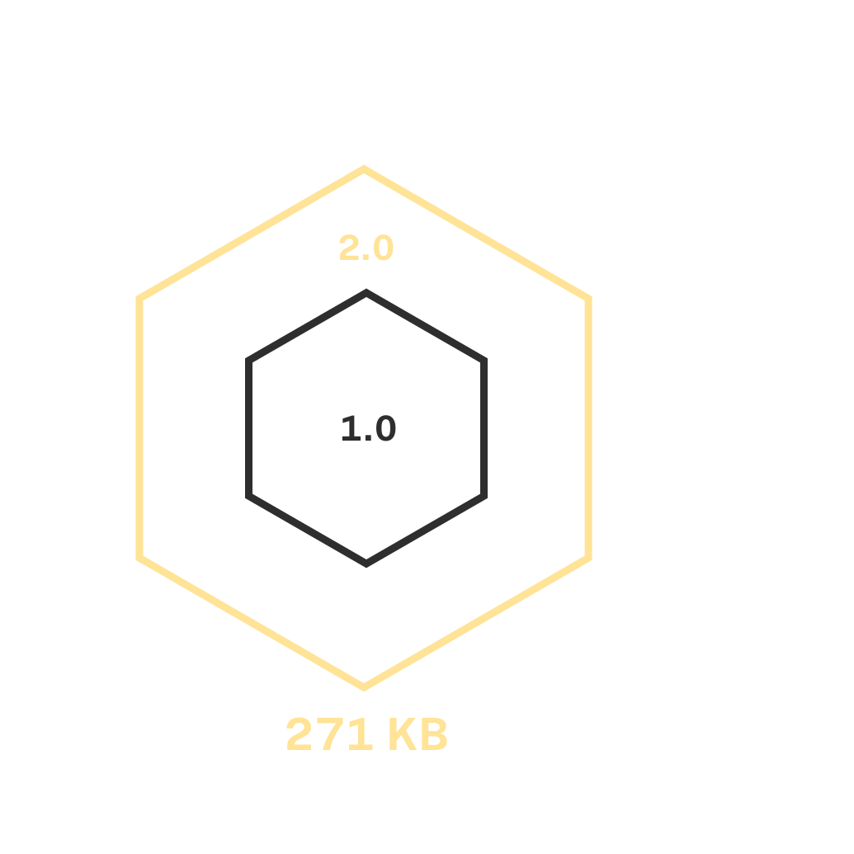
USWDS 2.0
20 Components
Utilities

Slide 14
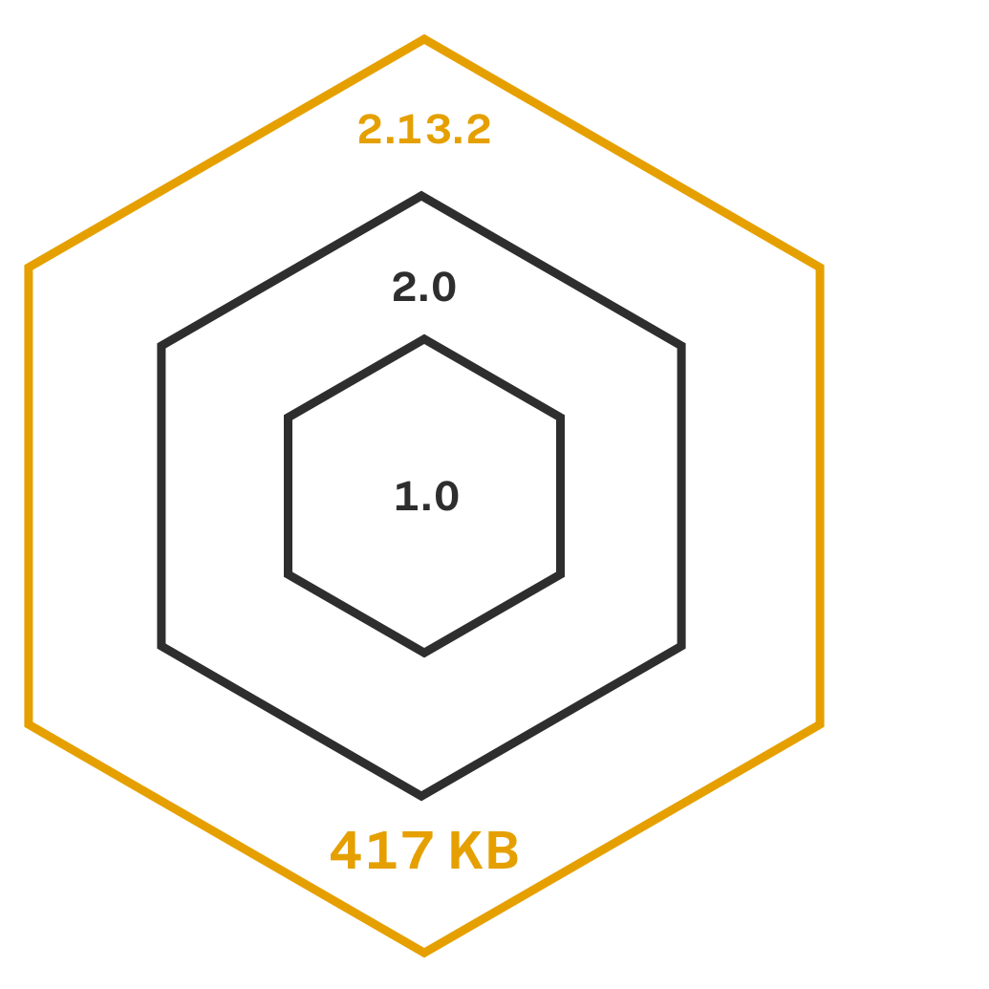
USWDS 2.13.2
40 Components
Utilities

Slide 15
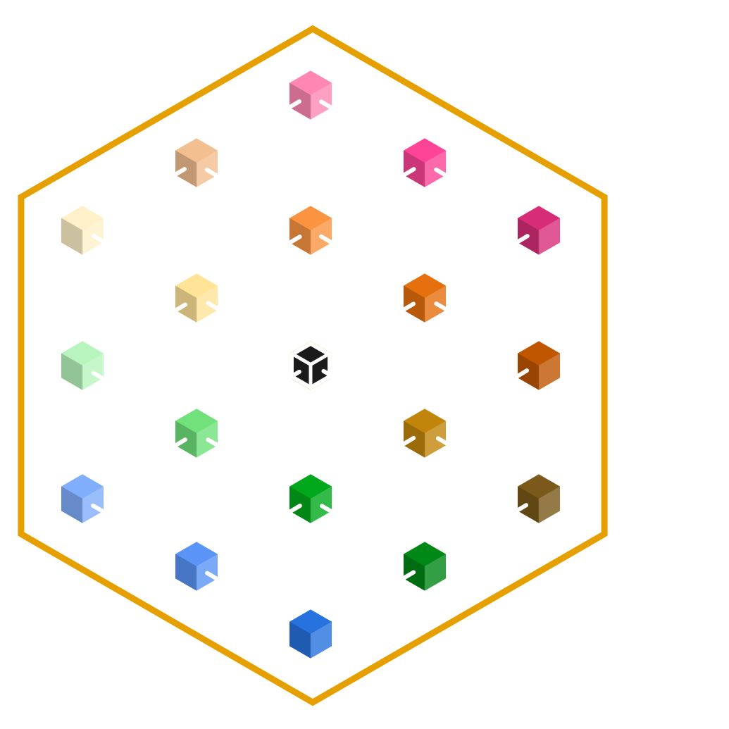
USWDS 3.0
We plan to keep growing.

Slide 16
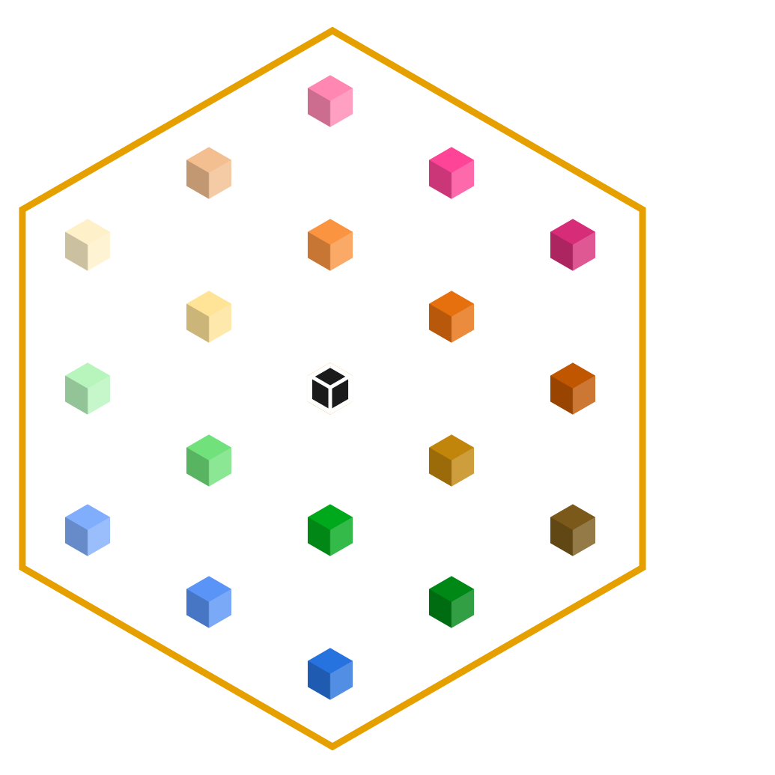
Now USWDS can keep growing without bloating your project CSS
USWDS 3.0 unbundles the design system into individual modular packages.

Slide 17
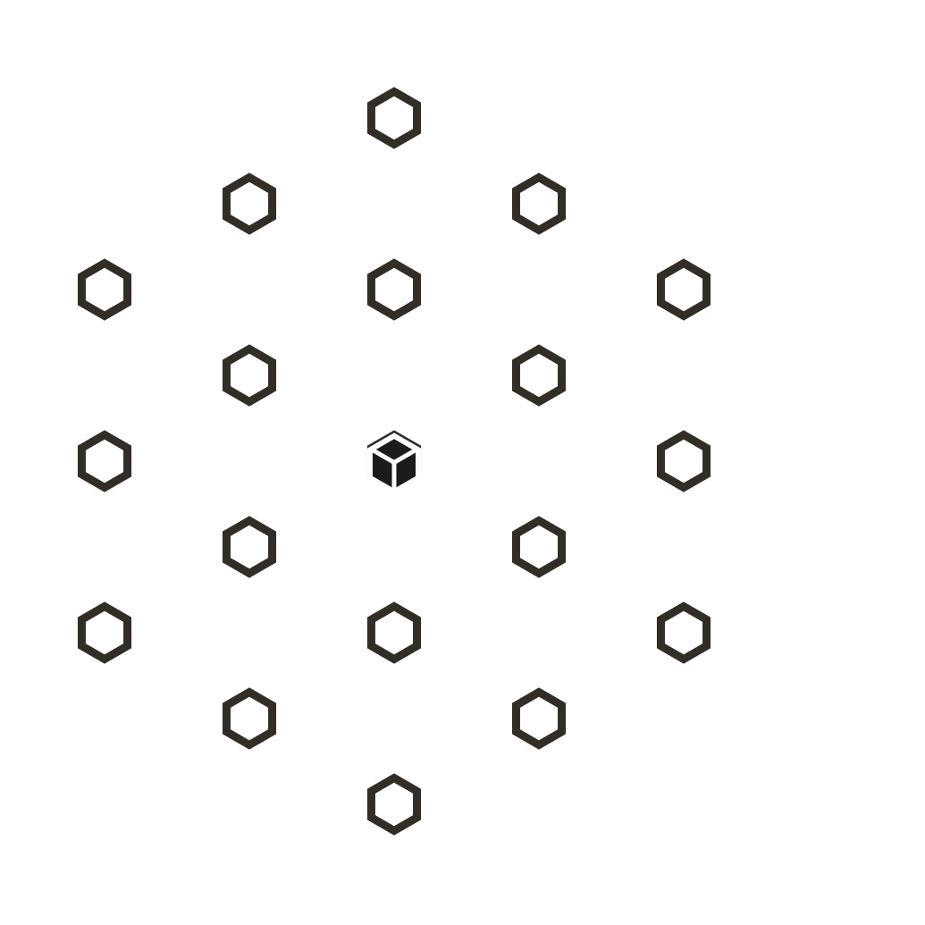
What is a package?
In USWDS, a package is a independently installable feature or component.

Slide 18
Package prefixes
usa-prefixed classes are components.
uswds-prefixed packages are everything else: bundles of multiple components or other non-component styles.

Slide 19
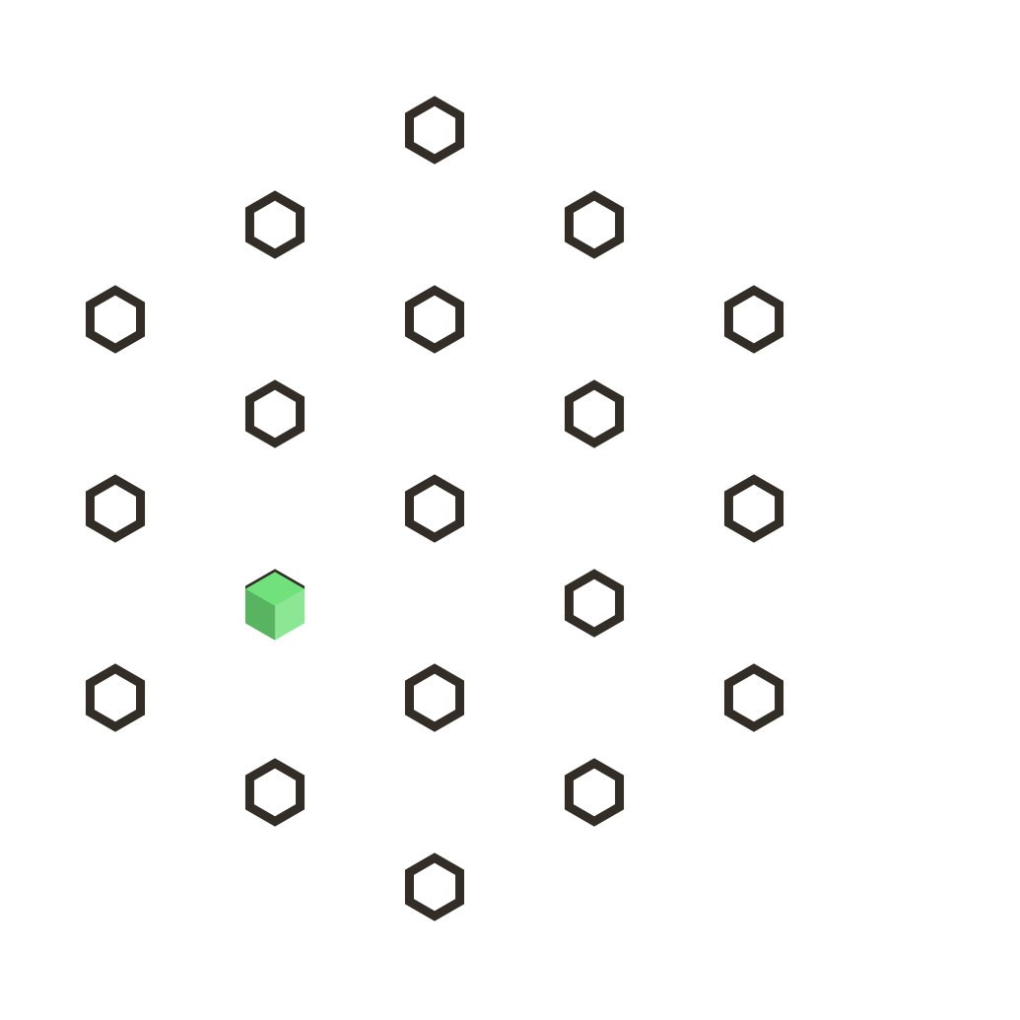
usa-banner

Slide 20
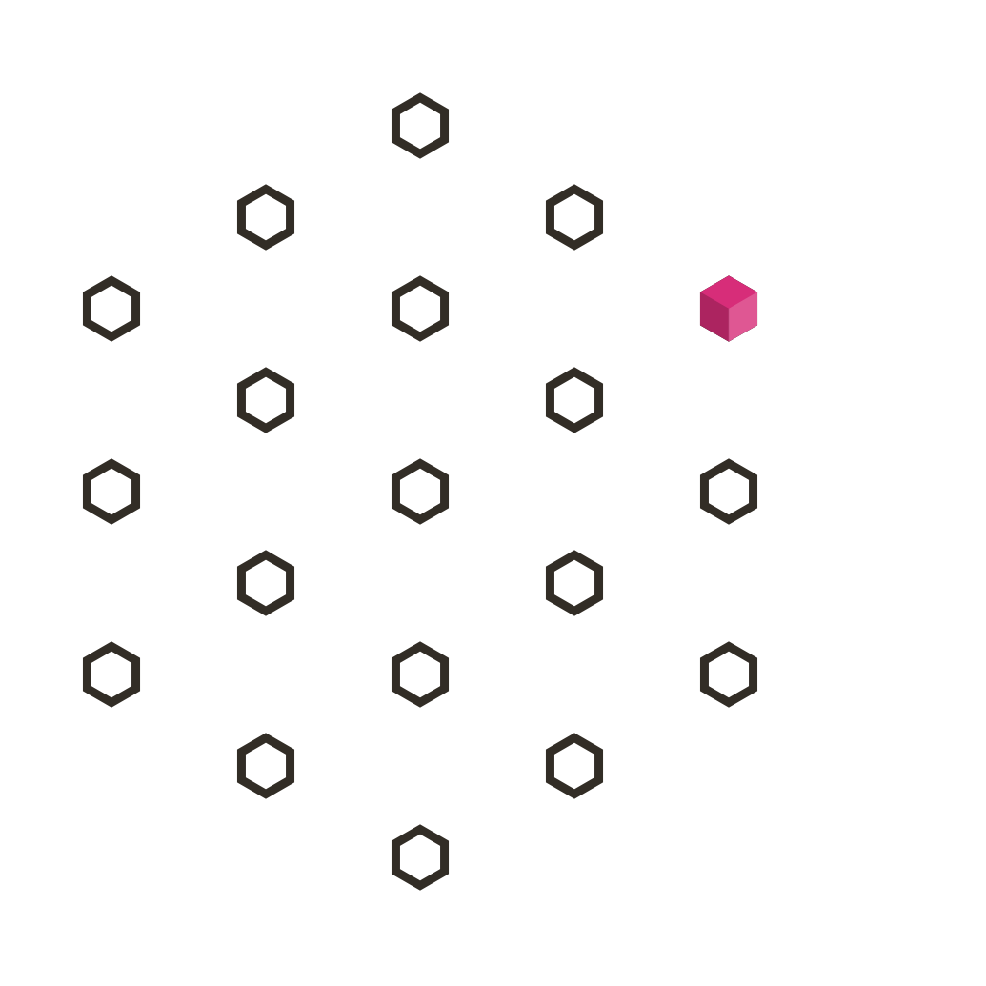
usa-footer

Slide 21
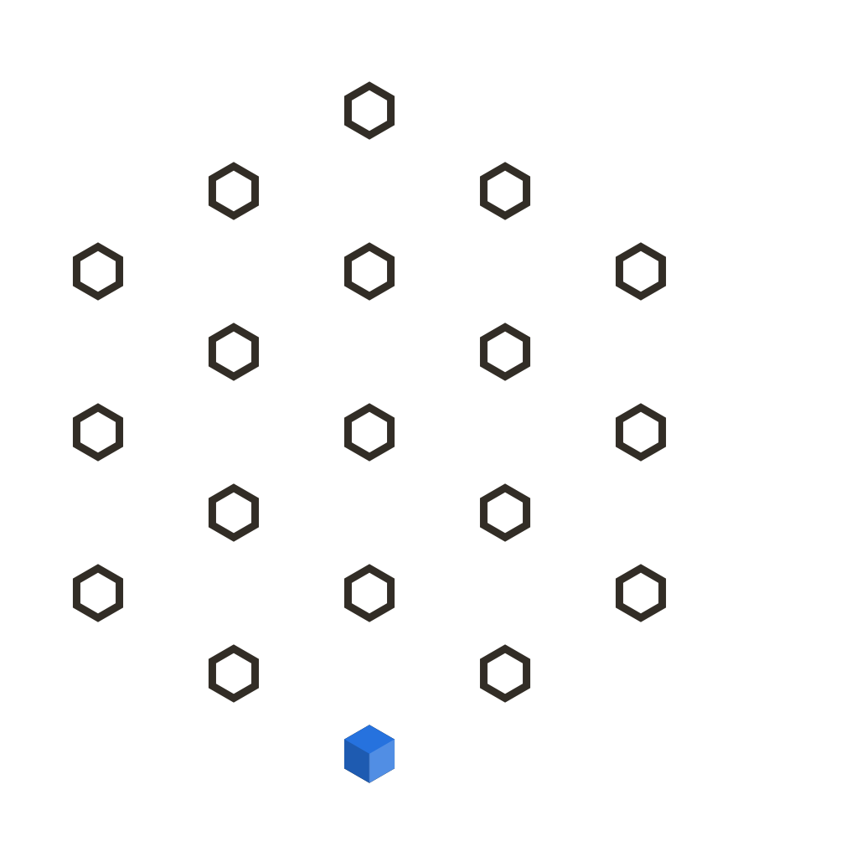
uswds-utilities

Slide 22

Use just the design system components your project needs
If you don’t use the whole design system, you shouldn’t include the whole design system in your CSS.

Slide 23
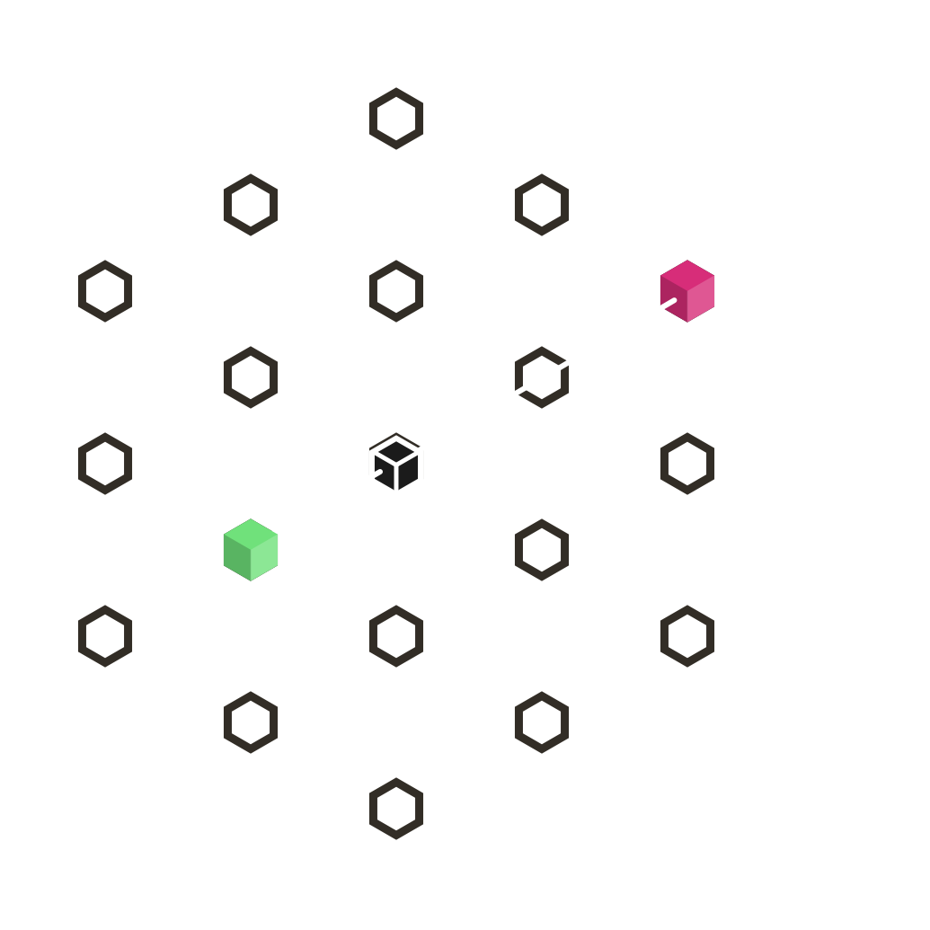
Small footprint
Just the banner and the footer

Slide 24
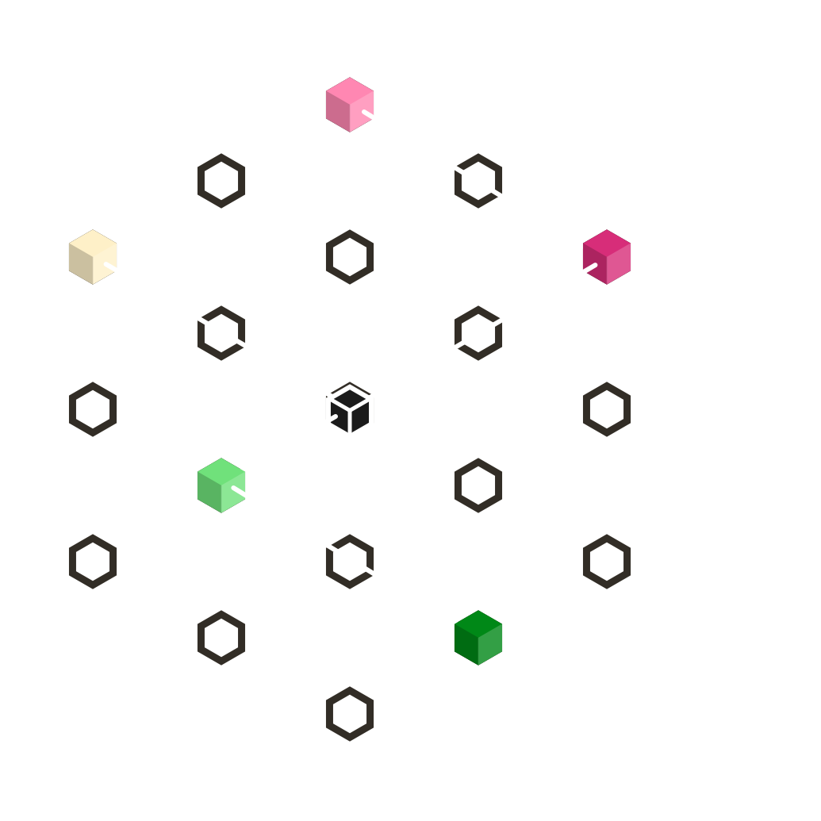
Medium footprint
Only a few components

Slide 25
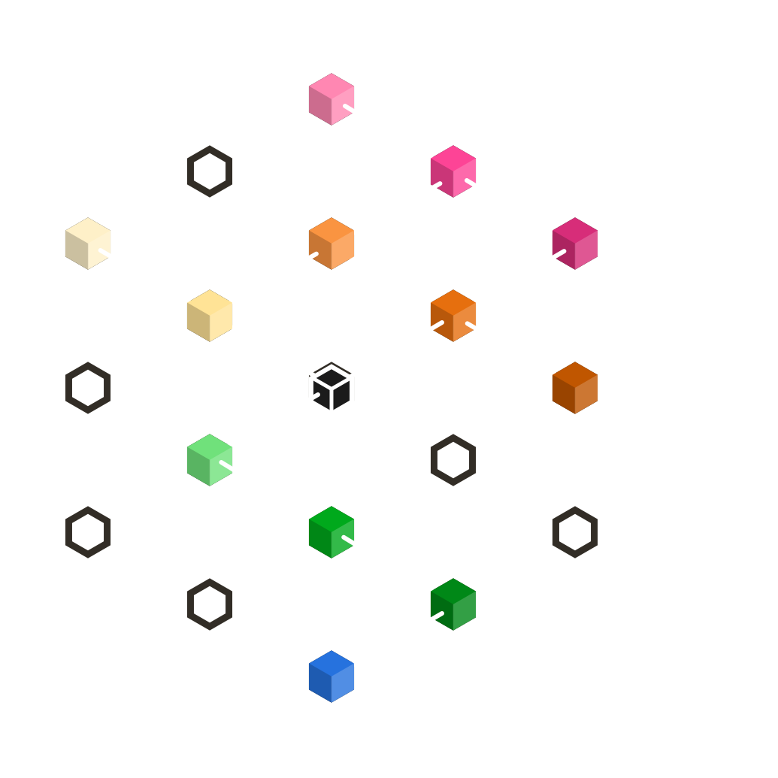
Large footprint
Even big projects probably won’t use every component.

Slide 26
Core only
A key package. Use the design language without adding CSS.

Slide 27
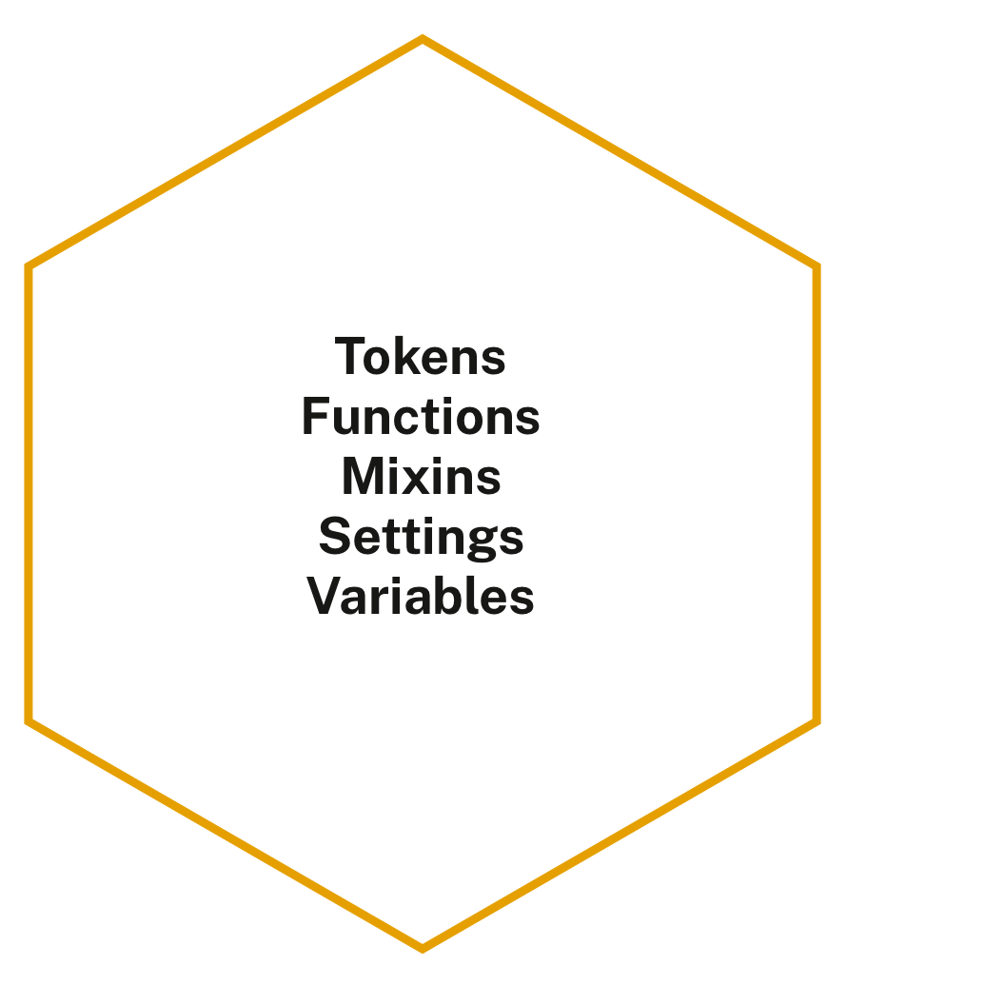
uswds-core powers every other package
It doesn’t emit CSS, but contains the complete USWDS design language.

Slide 28
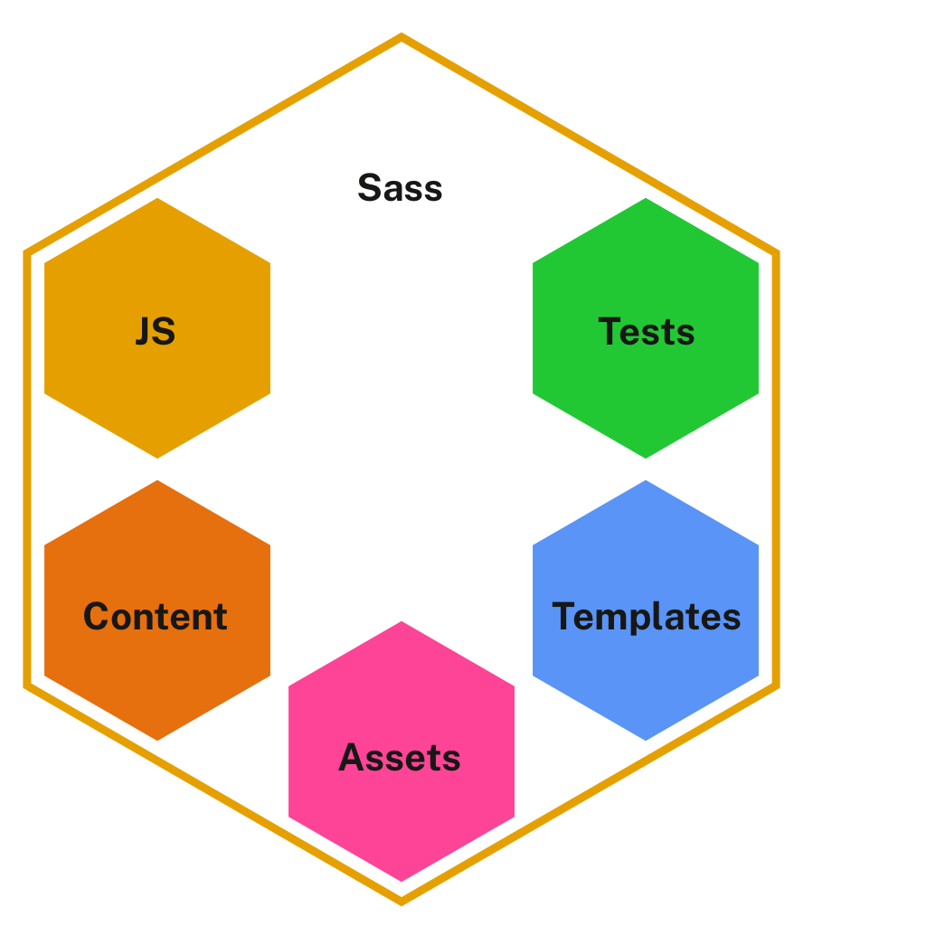
Package structure
An individual package includes everything a component needs to work.

Slide 29
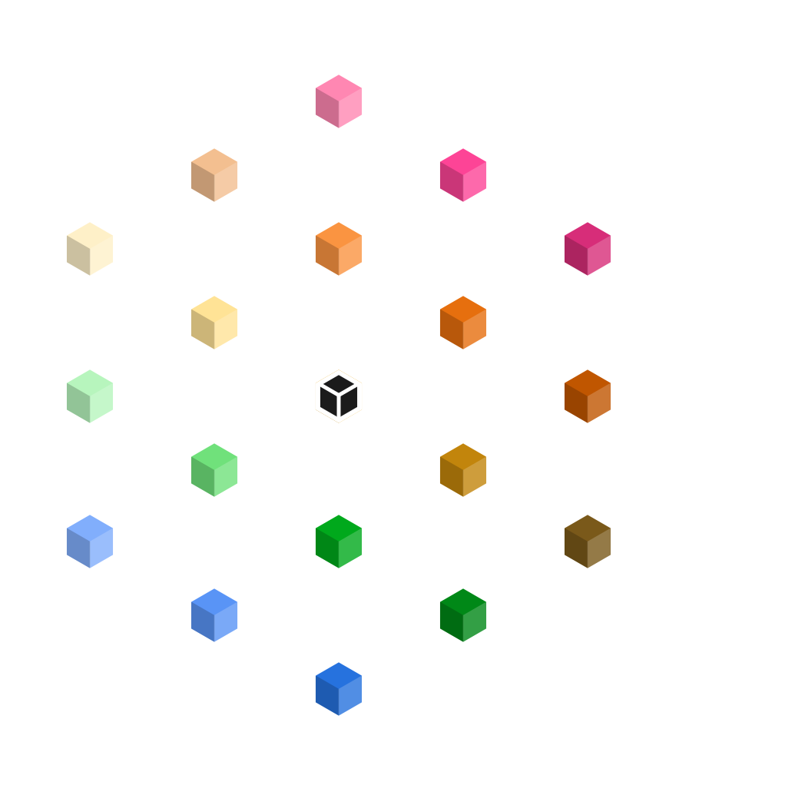
Every component is a package
Components have different needs, but each component is an individual package.

Slide 30
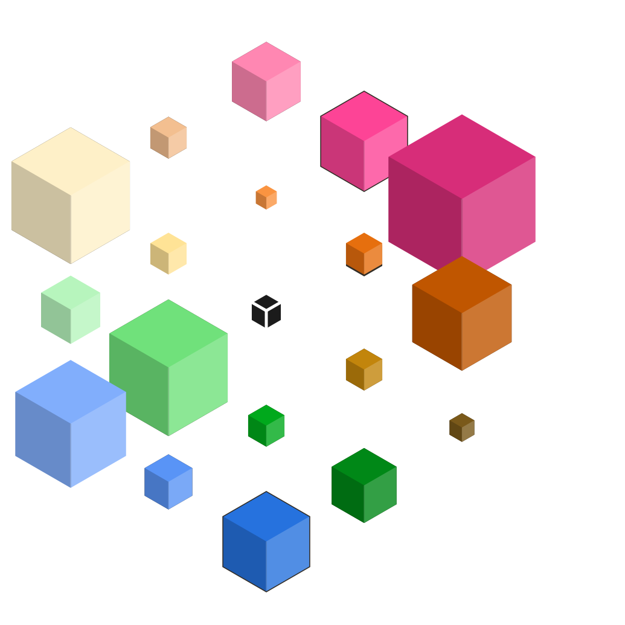
Different needs, different sizes
Some packages output a lot of CSS, some packages output only a little.

Slide 31
Everything: 417 KB
In a single bundle, the USWDS package is quite large

Slide 32
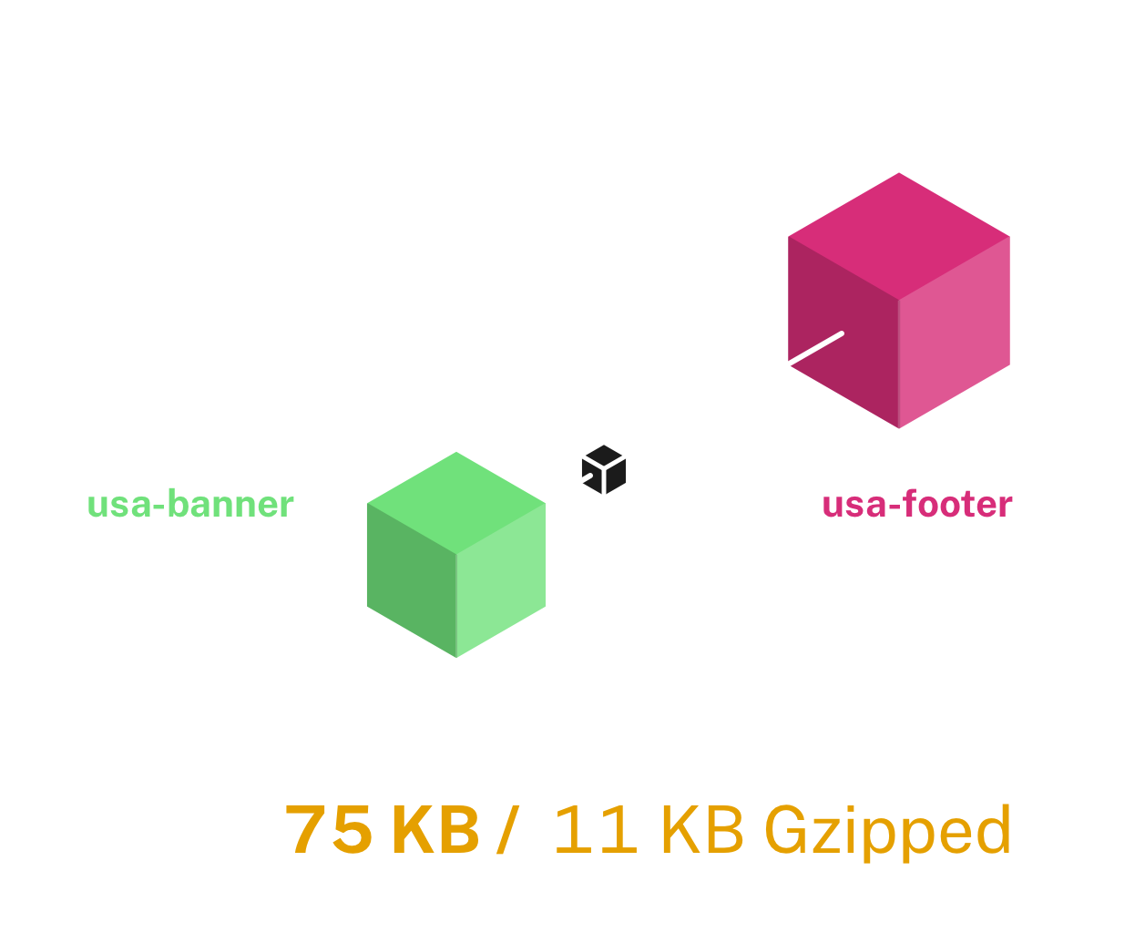
Using banner and footer
Using only a couple important components can save you over
80% over
the bundled
version.

Slide 33
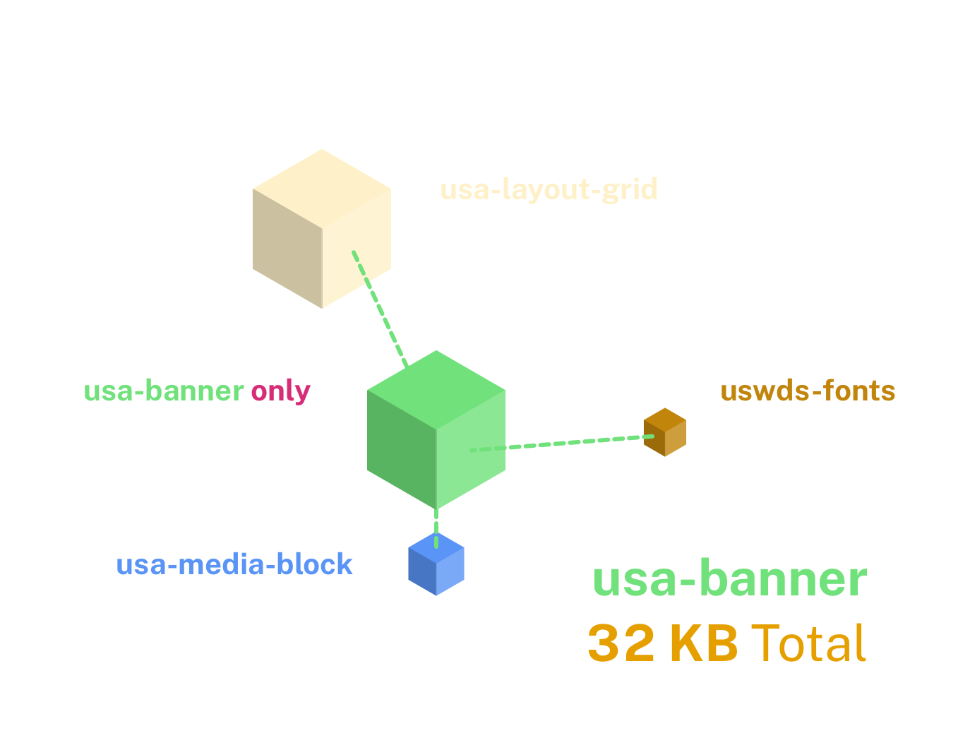
Package dependencies
The usa-banner package pulls in a few other packages
it needs to properly
display.
These are called its package
dependencies.

Slide 34
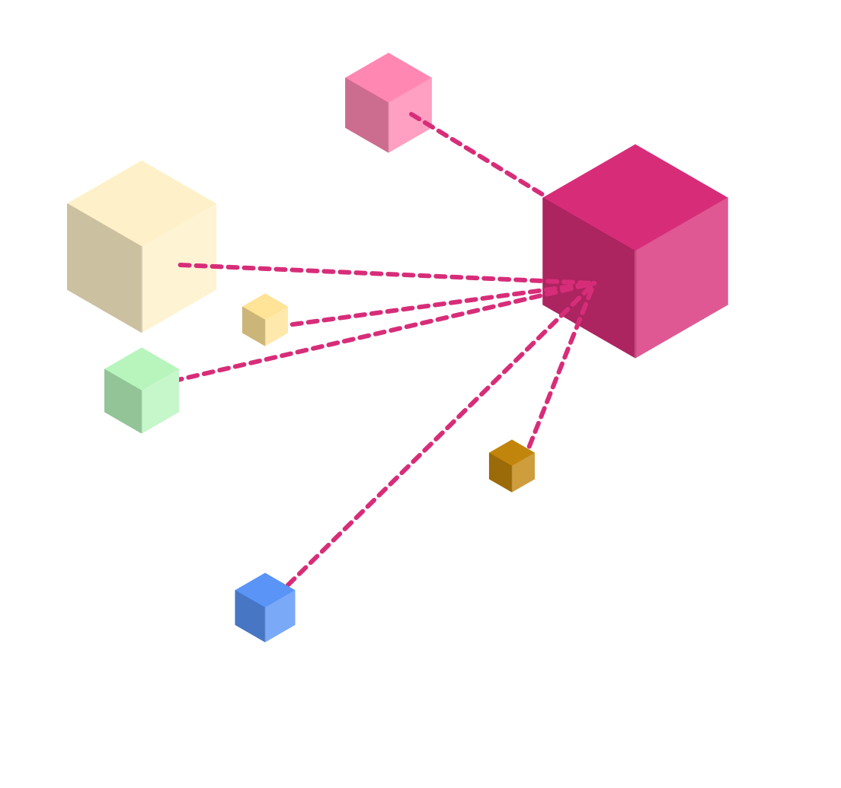
Footer dependencies
The usa-banner package also has dependencies.
Every package
is dependent on
at least one other.

Slide 35
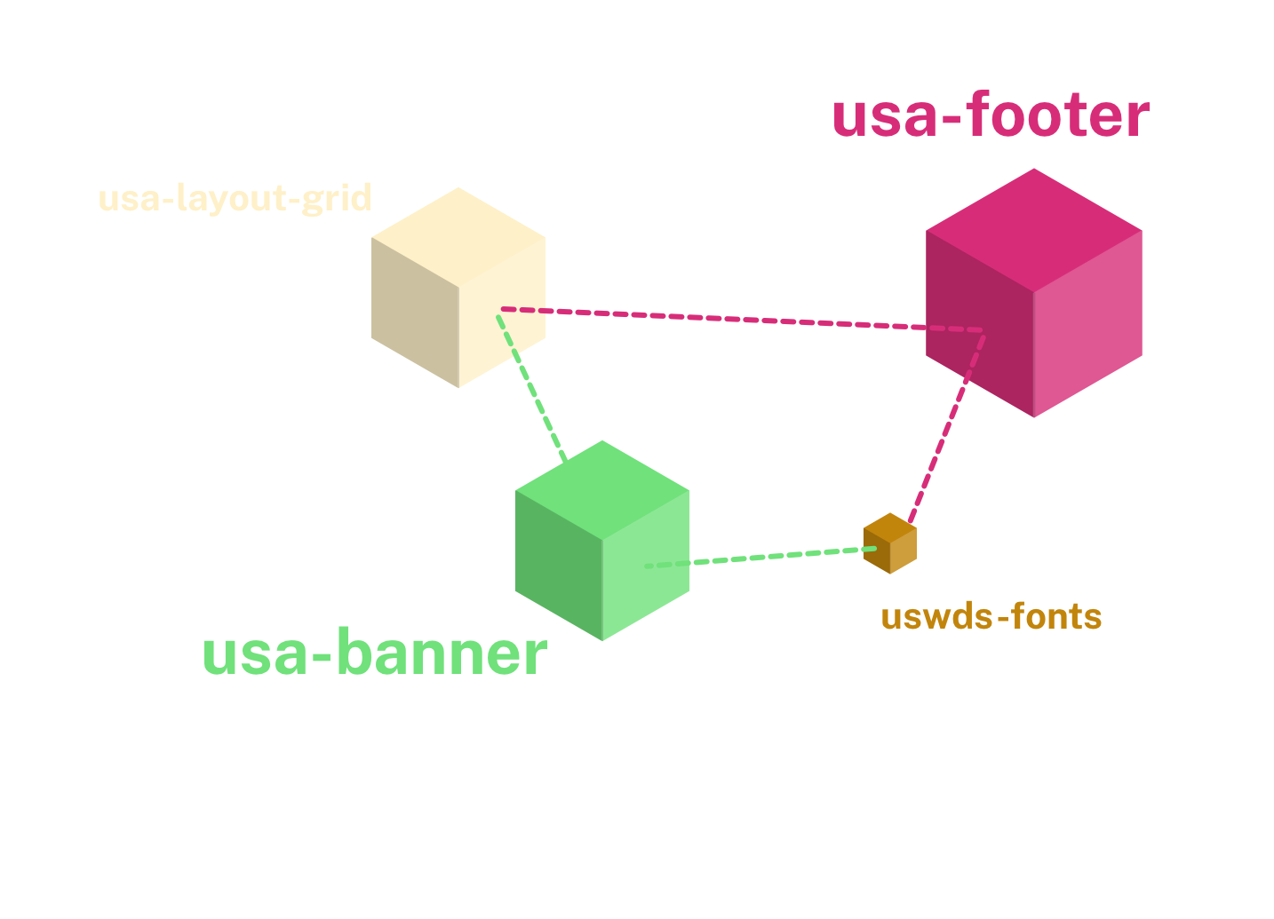
Shared dependencies are only included once
This is a key benefit
of the
Sass Module
syntax in
USWDS 3.0.

Slide 36

Some packages are affected by settings
A few packages get output more or less CSS depending on your project settings.

Slide 37
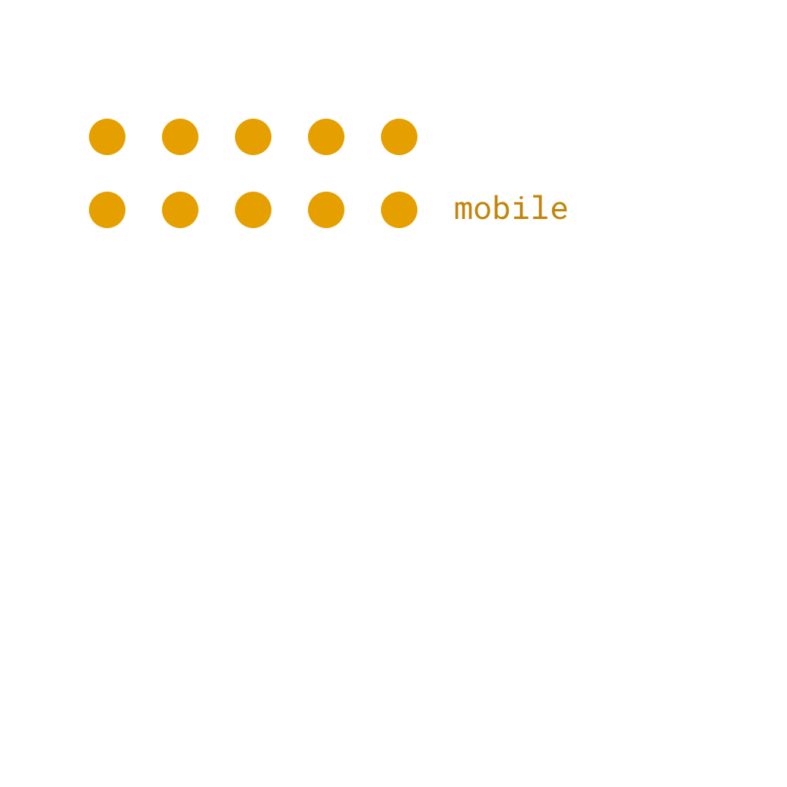
Adding responsive breakpoints adds new CSS rules
The layout grid package includes responsive classes, based on which responsive breakpoints are in your project.

Slide 38
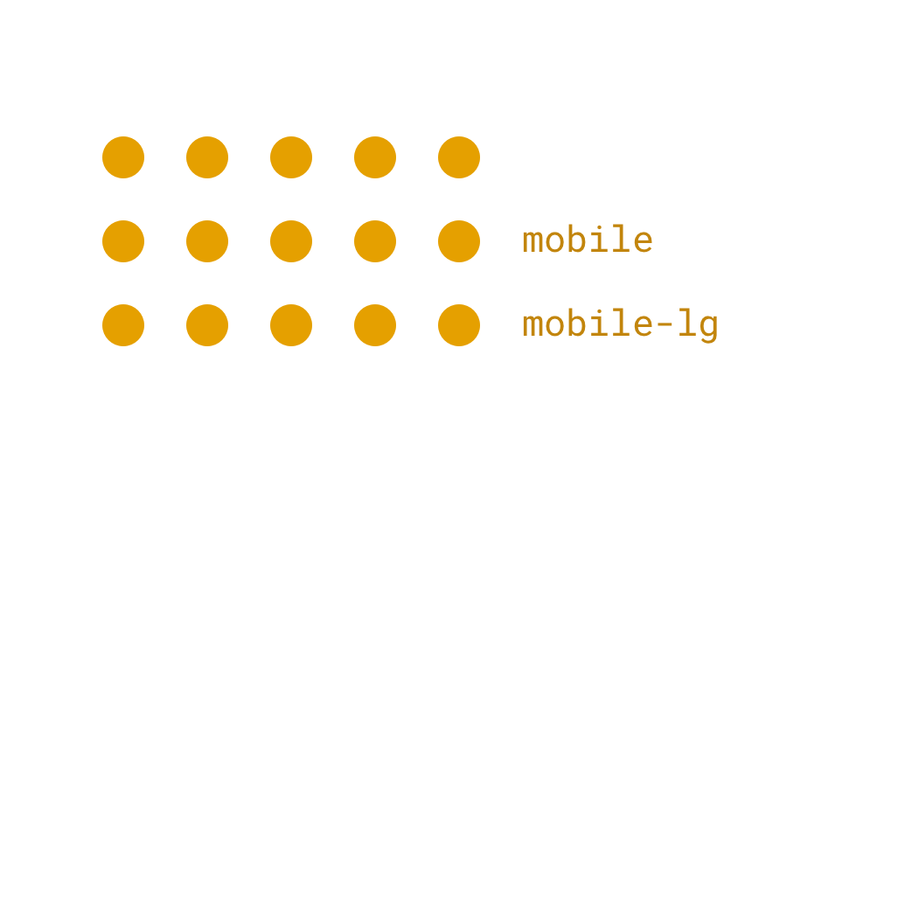
The more you add, the more CSS is output

Slide 39
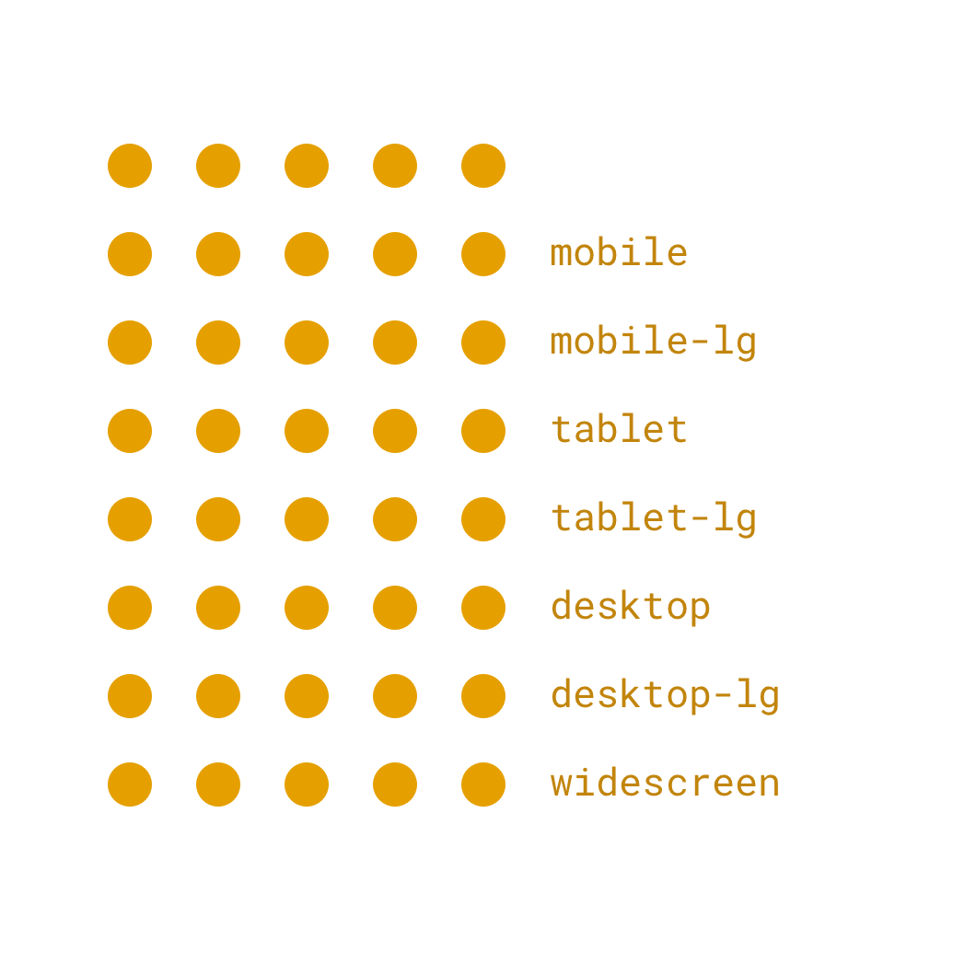
Including many breakpoints can have a big effect
Responsive breakpoints can serve as a CSS multiplier.

Slide 40

Utilities start small
Utility classes are even more sensitive to settings than the layout grid.

Slide 41
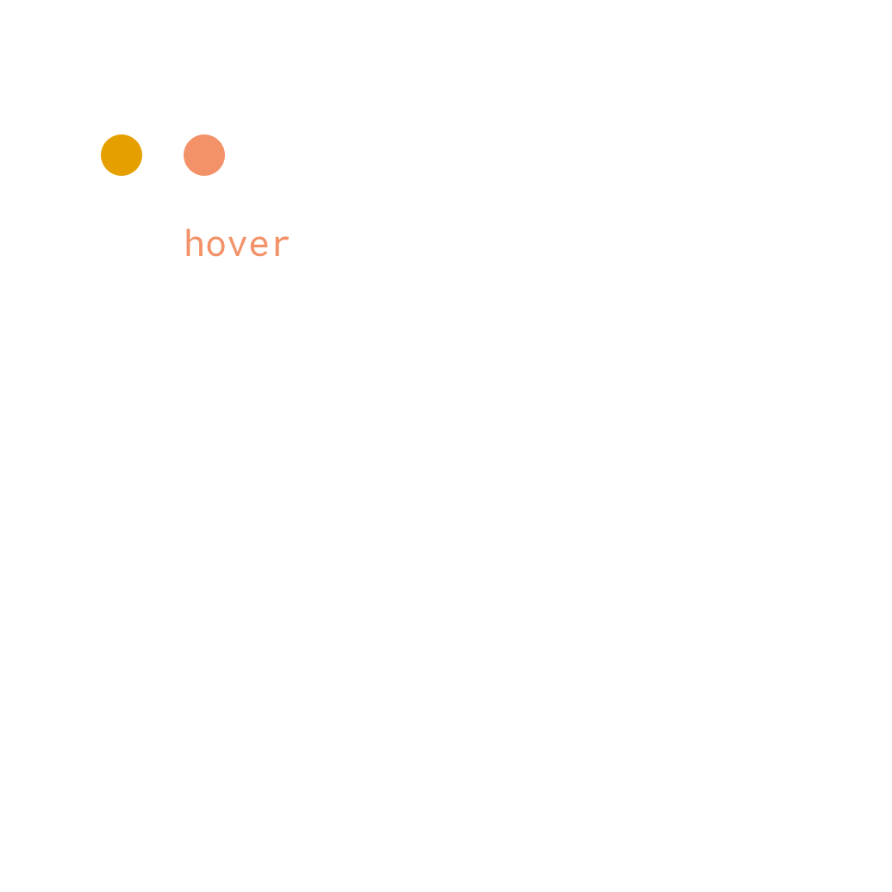
You can add state-based utility classes in settings
But each new state adds a bit more code

Slide 42
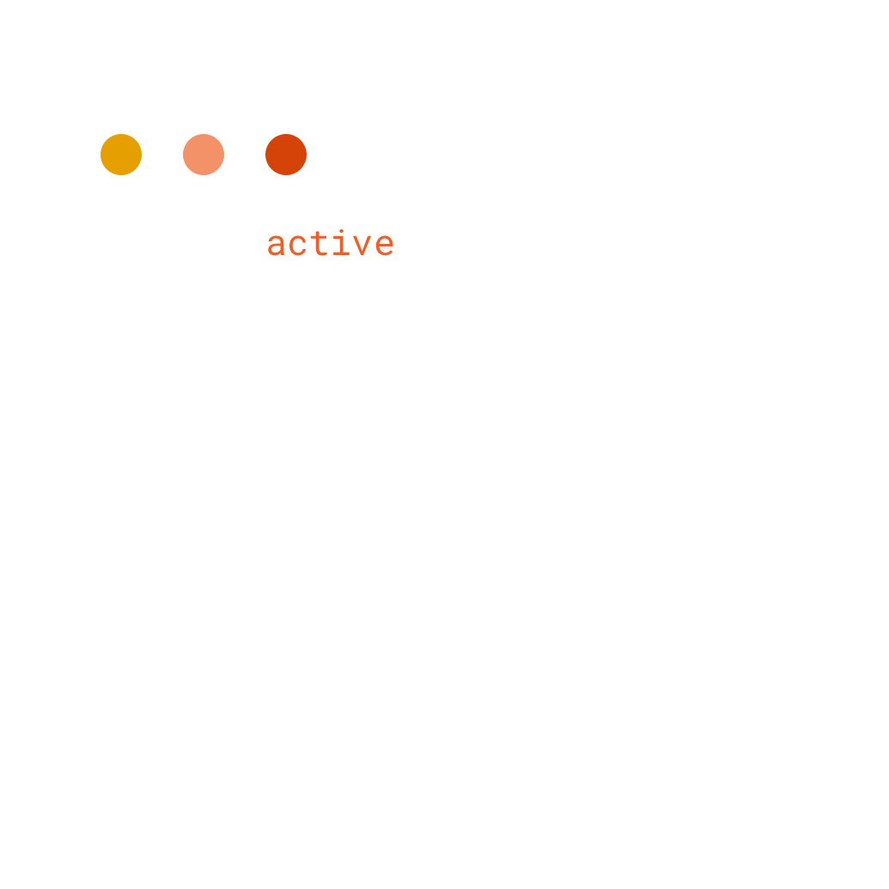
Active classes..

Slide 43
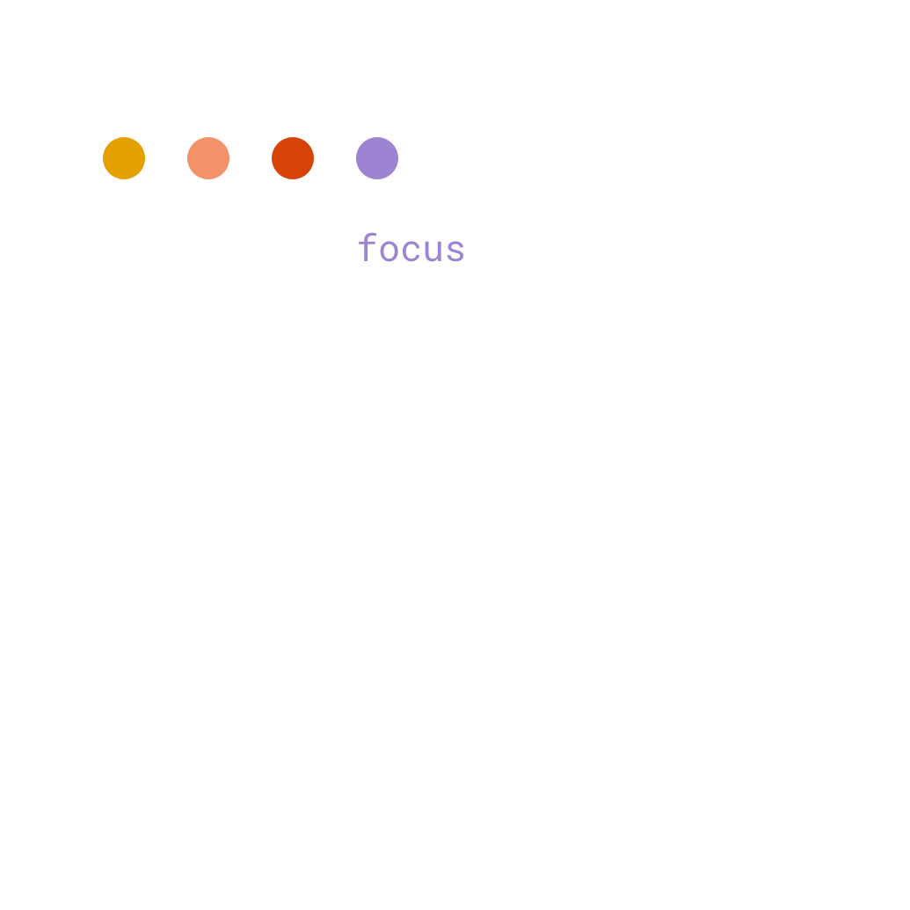
Focus classes…

Slide 44
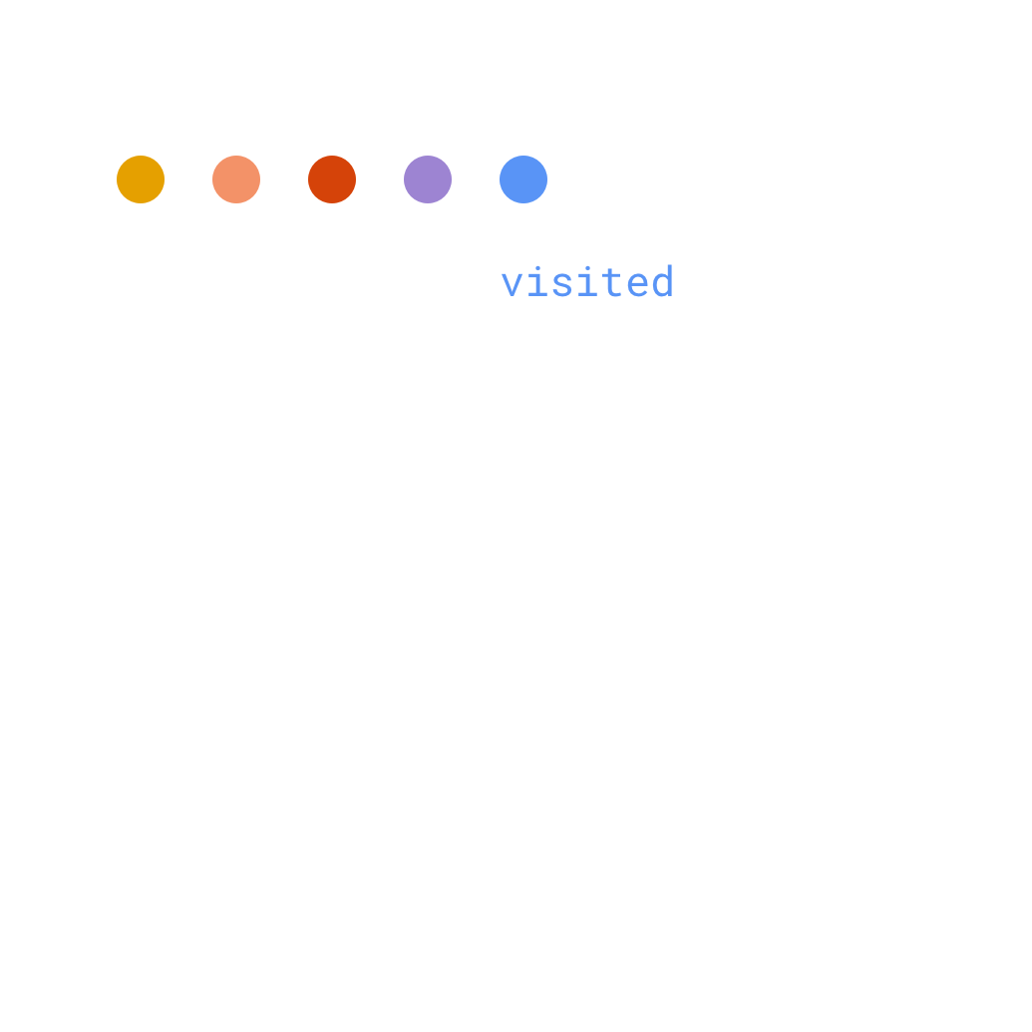
…and visited classes.

Slide 45
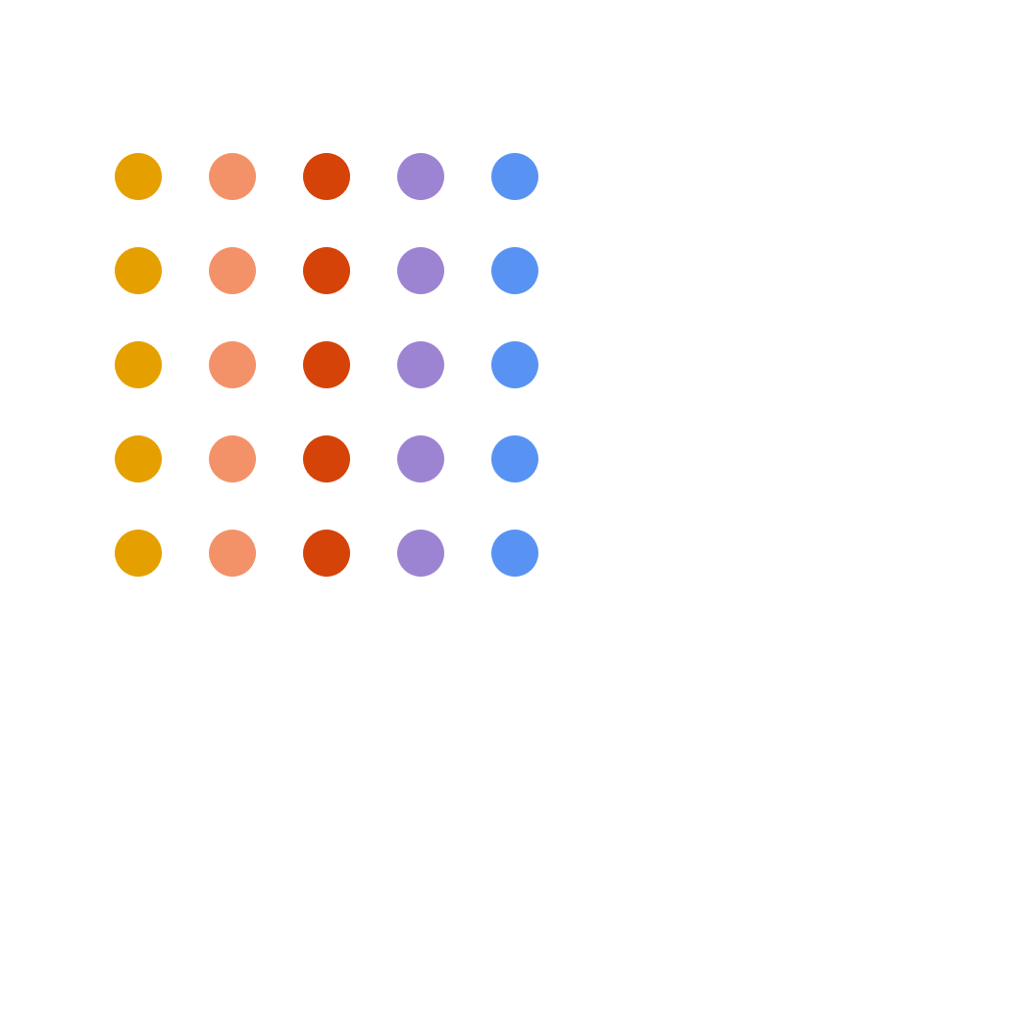
These are multiplied by the responsive breakpoints
Each new utility variant is a multiplier.

Slide 46
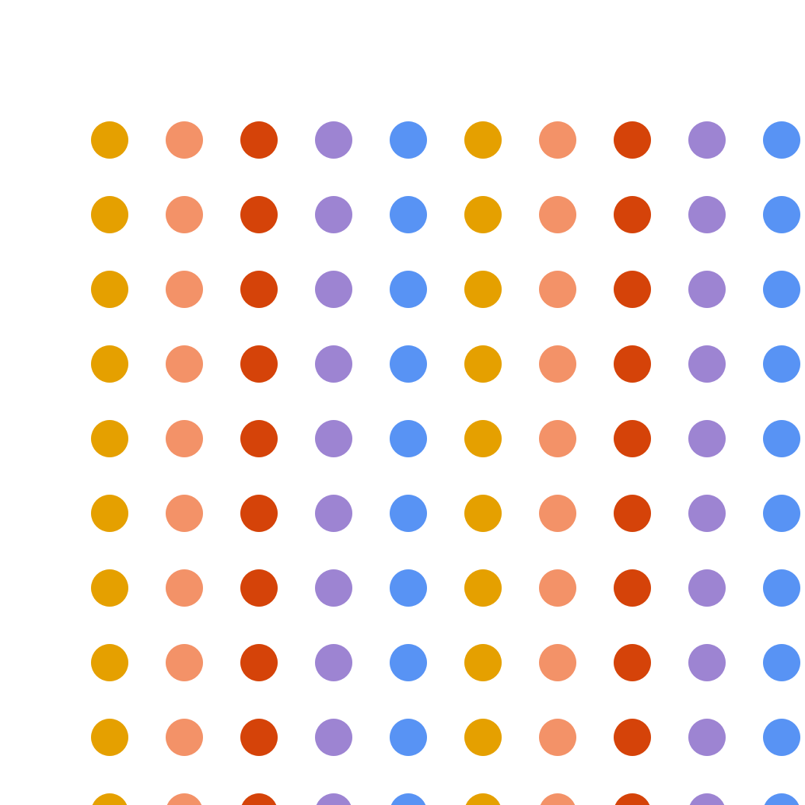
The more output utilities, the more output CSS
Even a few new variants, spread over multiple utilities can have a big effect.

Slide 47
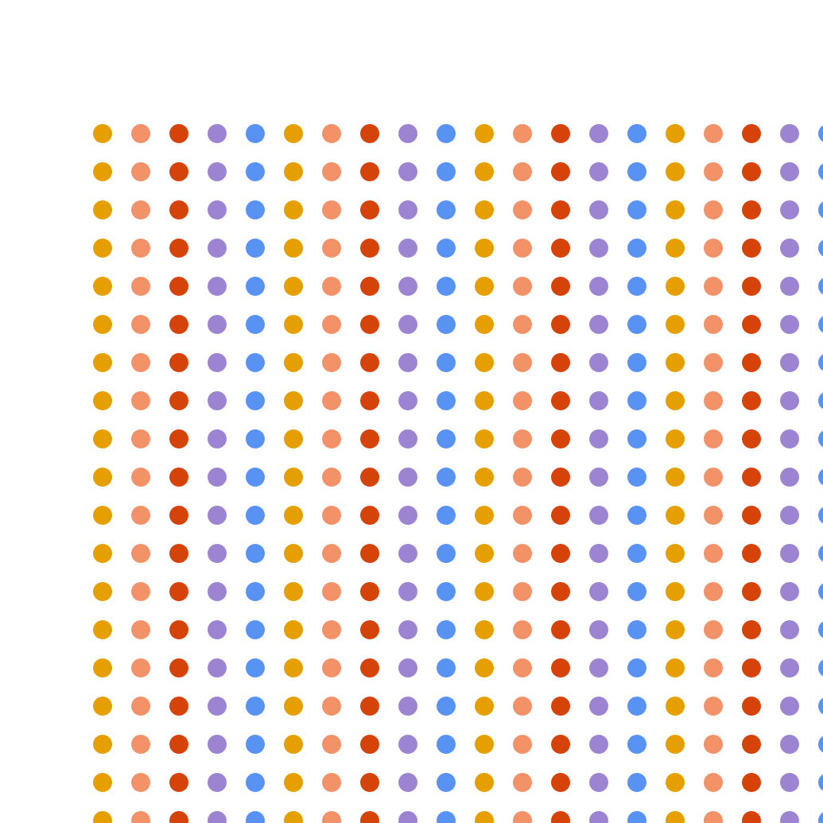
This can quickly multiply
The more utilities you're using, the bigger the effect.

Slide 48
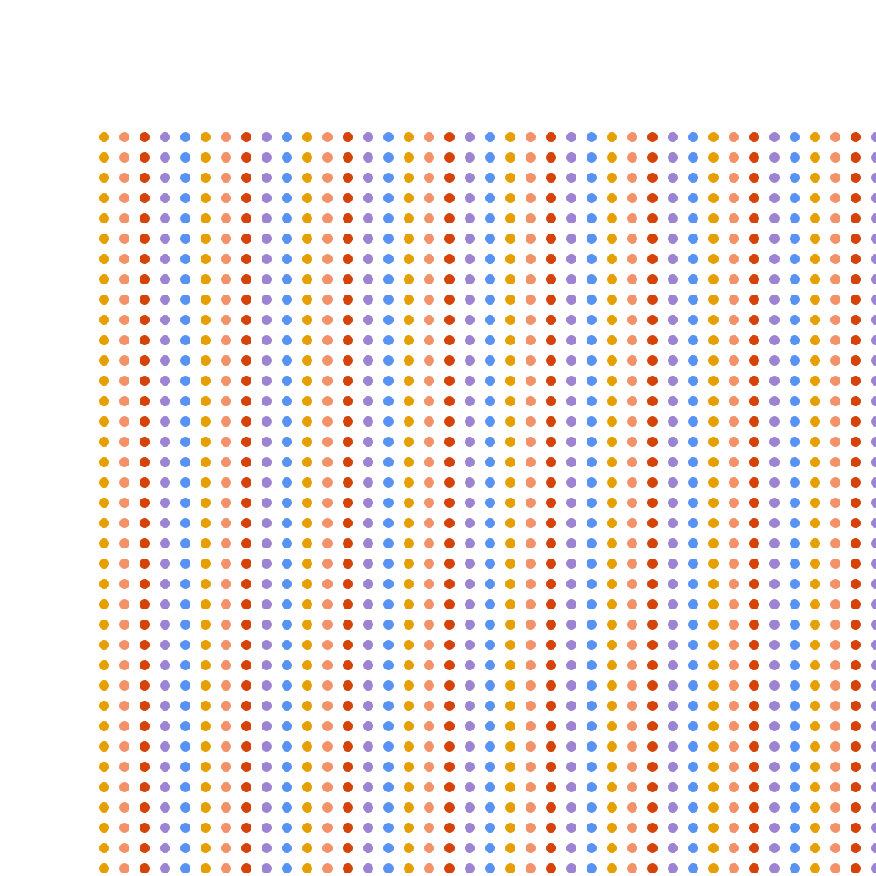
Before you know it, utility size can get out of hand
In most projects, the bulk of unused code is coming from utility classes.

Slide 49

Utilities package
The utilities package has more customization options than any other package.

Slide 50
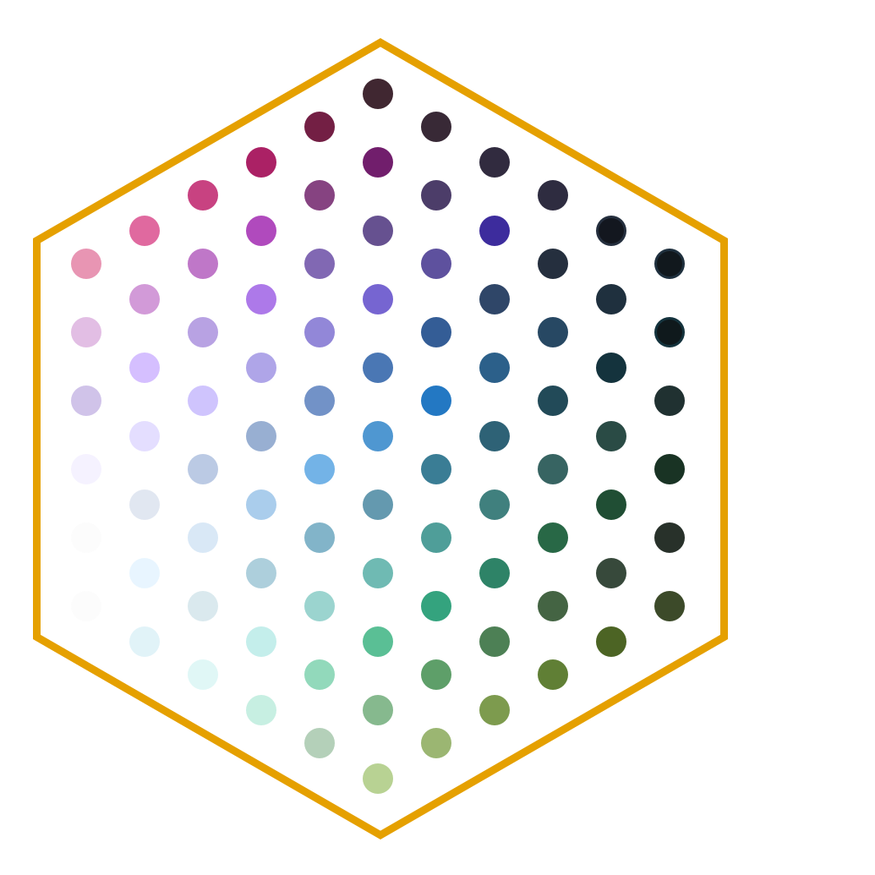
Utilities modules
Each utility in the utilities package has its own module. USWDS has over 60 utility modules.

Slide 51
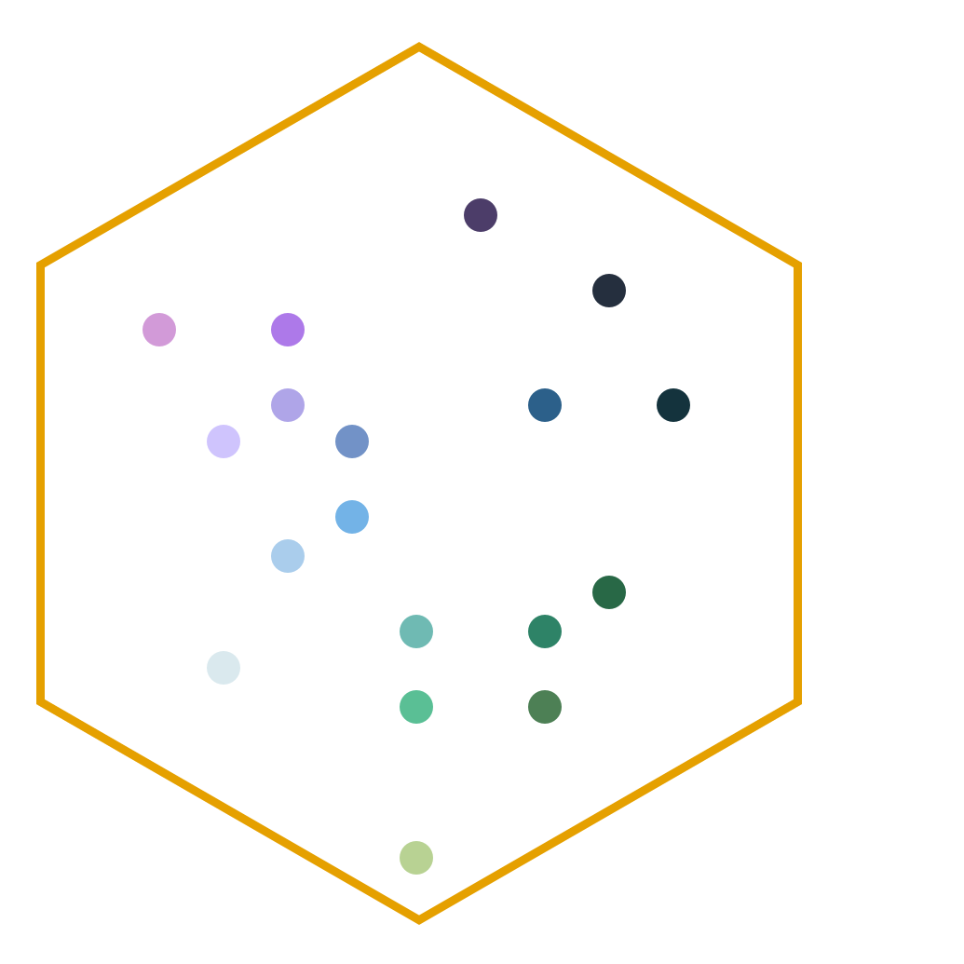
Utilities modules for your project
Just as with component packages, most production websites will use only a few utility modules.

Slide 52
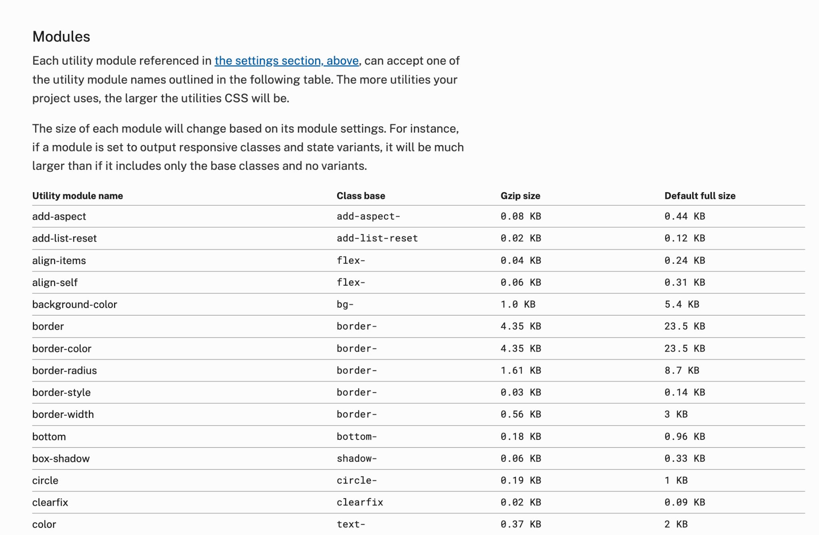
Utilities docs
Our docs go into more detail about using utility modules.
designsystem.digital.gov/utilities

Slide 53
$output-these-utilities
$output-these-utilities {
"align-items",
"background-color",
"border",
"color",
"flex",
"margin-vertical",
"padding",
"width"
}
This new setting allows you to create a list of the utility modules your project needs.

Slide 54
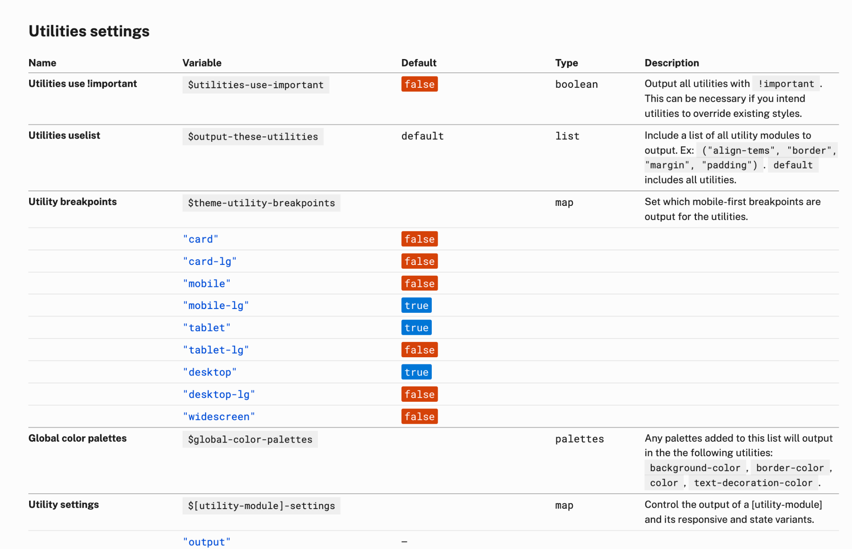
Settings docs
Adjust utility breakpoints and other utility output.
designsystem.digital.gov/documentation/settings

Slide 55
$theme-utility-breakpoints and $[module]-settings
$theme-utility-breakpoints: (
"mobile-lg": true,
"tablet": true,
"tablet-lg": true,
"desktop": true,
),
$width-settings: (
output: true,
responsive: true,
)
Control breakpoints and state variants

Slide 56
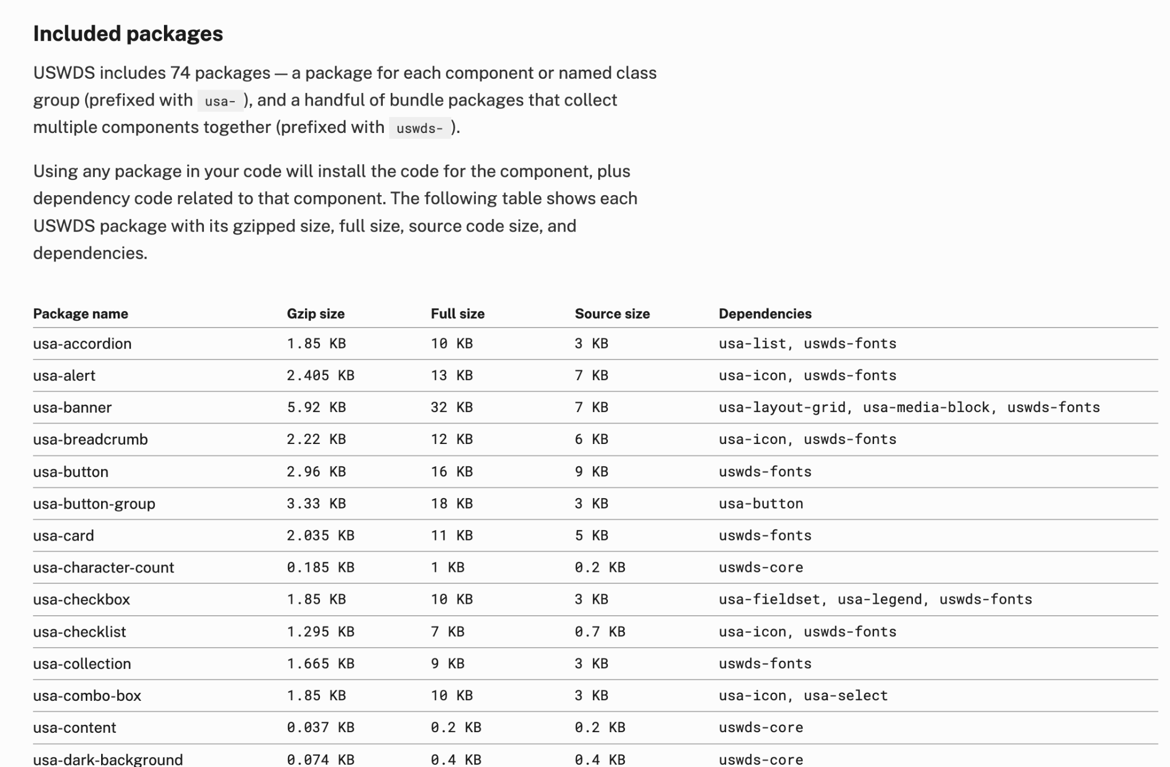
Component packages docs
Find all available packages
designsystem.digital.gov/components/packages

Slide 57
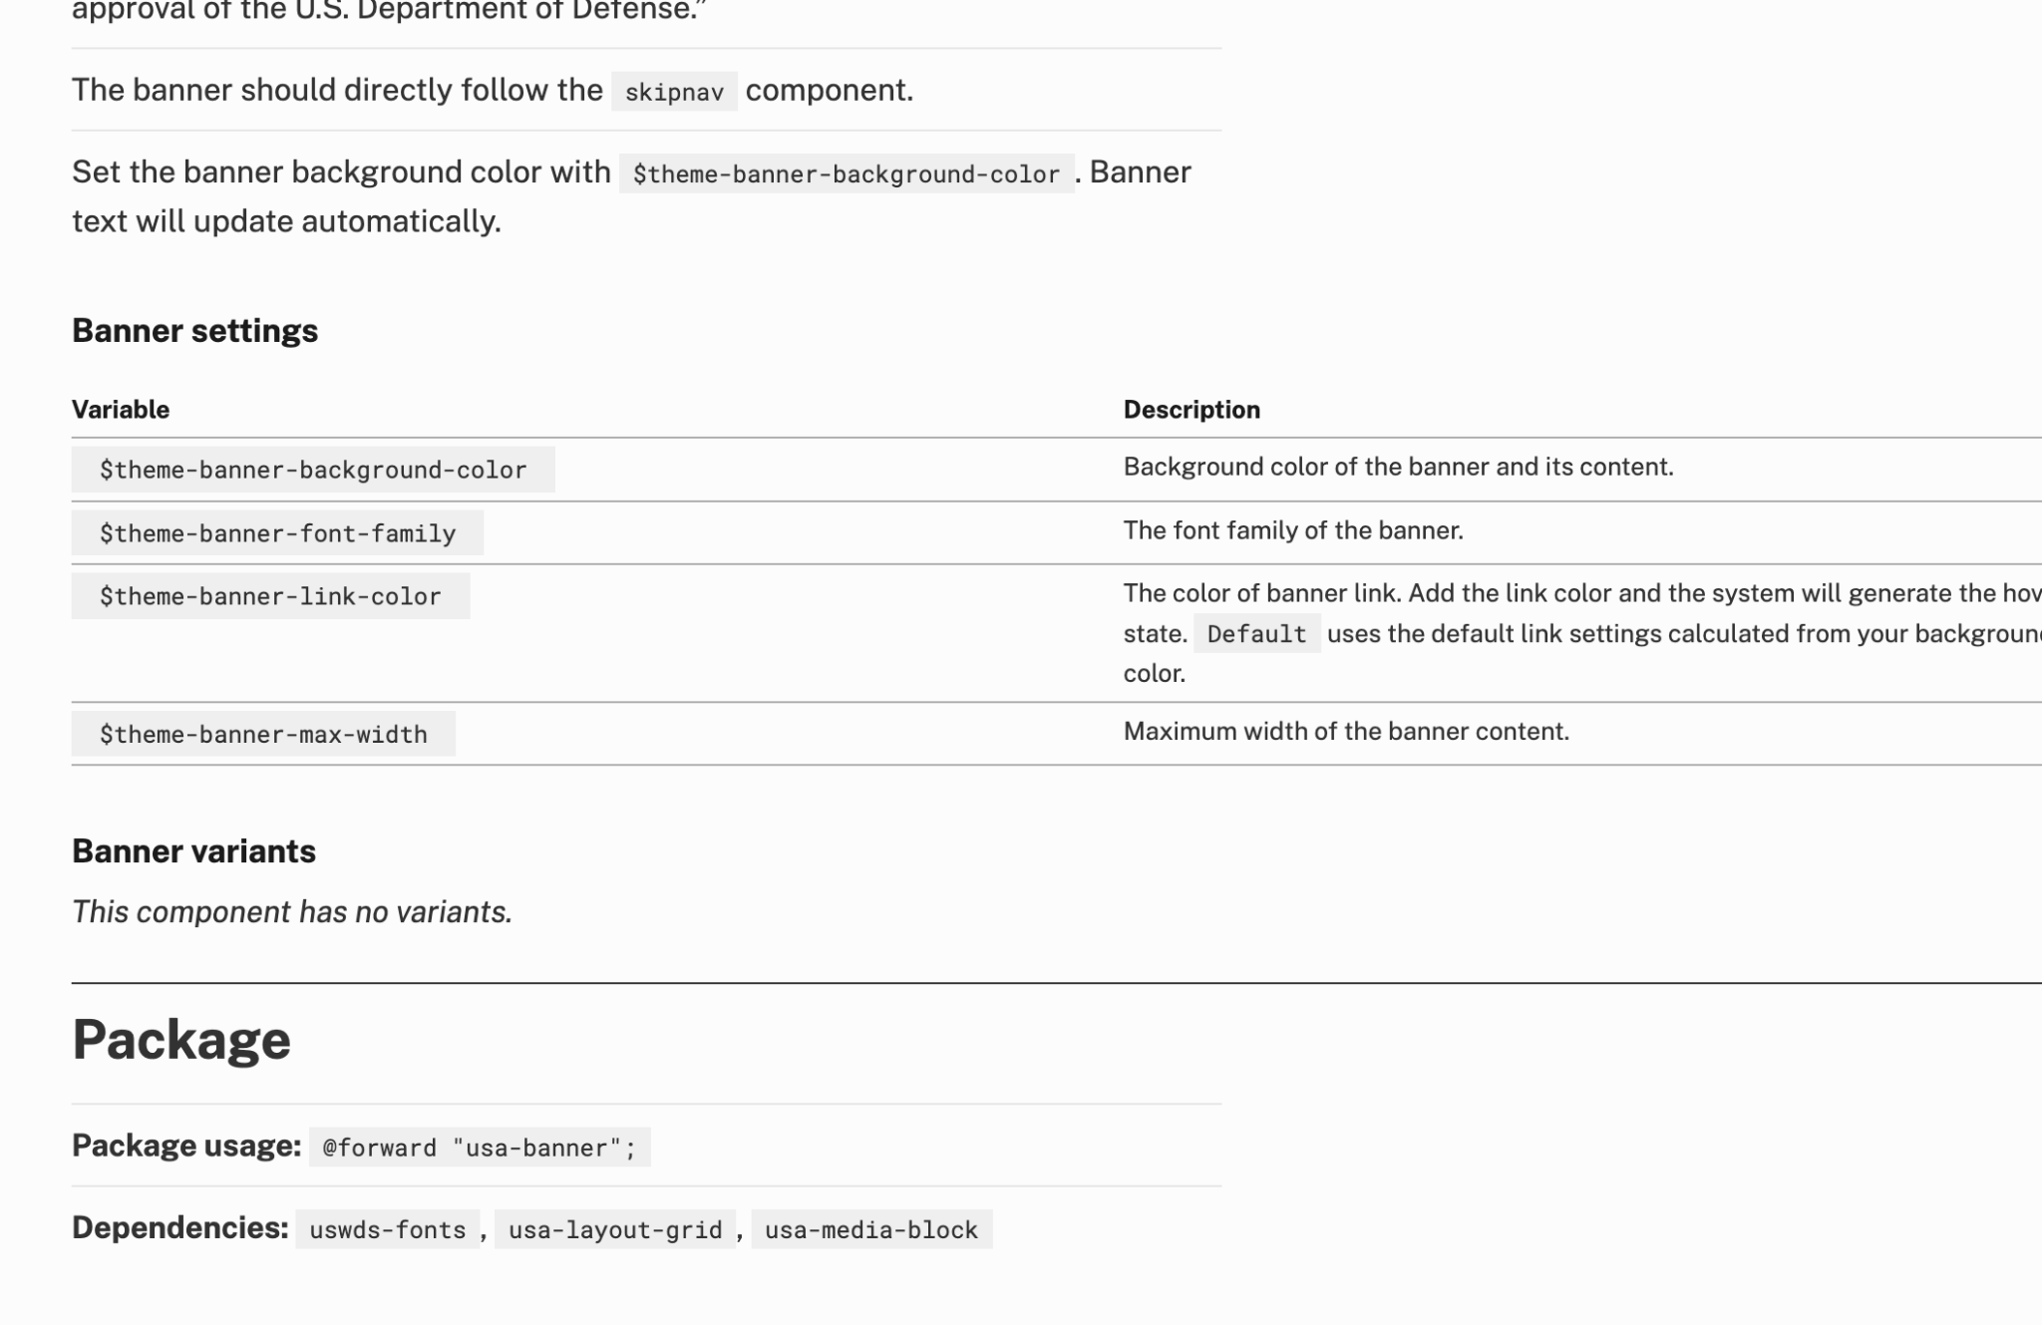
Component docs
Find package information on any component page
designsystem.digital.gov/components/packages

Slide 58
@forward
@forward "uswds"
@forward "usa-banner"
@forward "usa-footer"
@forward "uswds-utilities"
@forward "uswds-global"
Include only your project’s packages

Slide 59
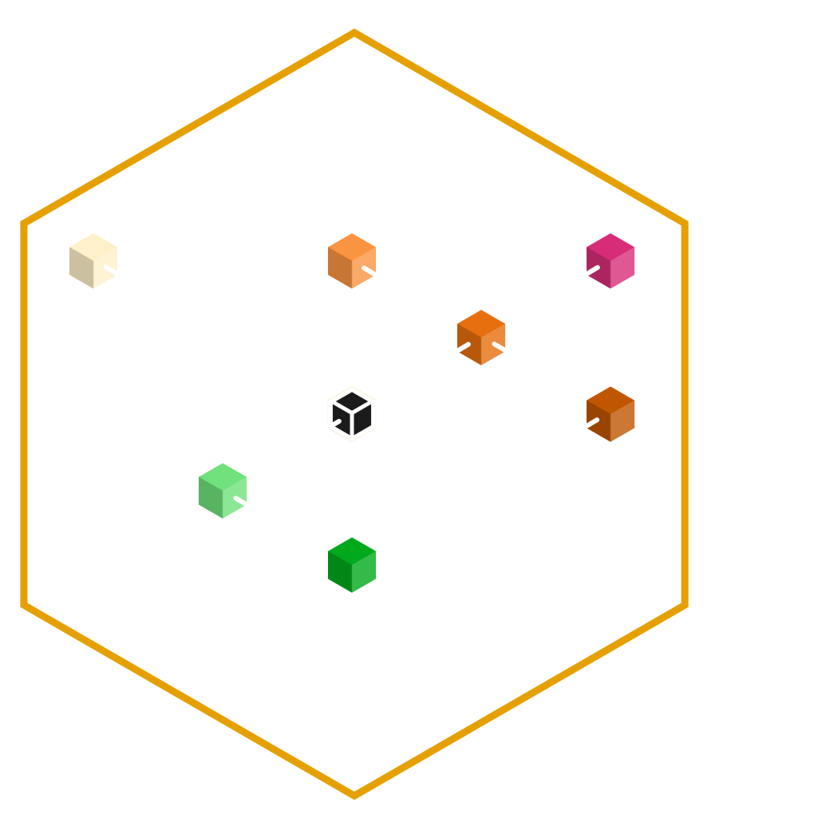
Project profile
Together, your settings form a unique project profile.

Slide 60
James Mejia
Developer
USWDS Core Team Contractor

Slide 61
Demo

Slide 62
Q&A

Slide 63
Next month
June: Improving our contribution model
USWDS Slack
Github
USWDS website

